Slide 1
EE4007 - OPTICAL ELECTRONICS
January 2010
© Alan P. Morrison
Lecture 4- Integrated optical waveguides, asymmetric slab waveguide, coupling light into waveguides

Slide 2
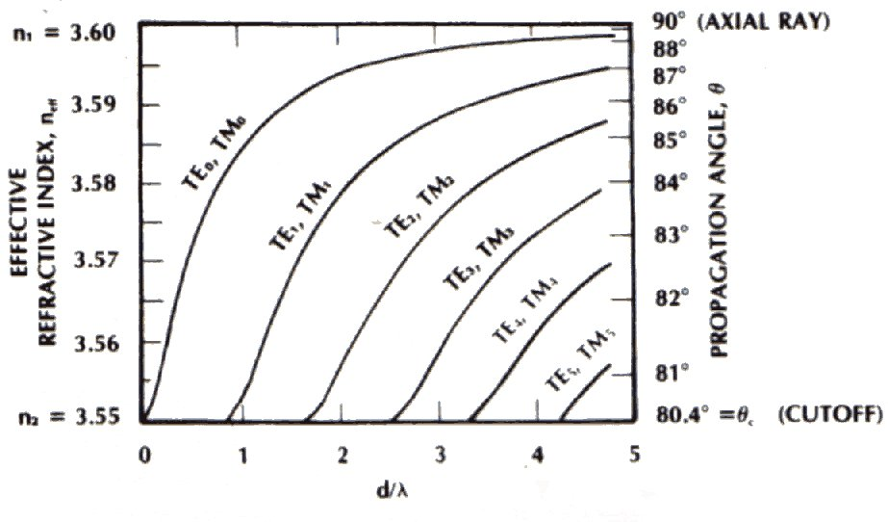
MODE-CHART
January 2010
© Alan P. Morrison

Slide 3
DIELECTRIC SLAB WAVEGUIDE
January 2010
Example: Find propagation angles, effective refractive indices, and the number of TE modes in an AlGaAs waveguide if d=1.64μm and the free-space wavelength is λ=0.82μm
    d/λ = 2
    Mode chart gives 3 TE solutions:(see previous slide)
    TE₀, n_{eff}=3.594, θ = 86.7º
    TE₁, n_{eff}=3.578, θ = 83.7º
    TE₂, n_{eff}=3.577, θ = 81.1º
    3 TE modes can exist simultaneously in this waveguide
© Alan P. Morrison

Slide 4
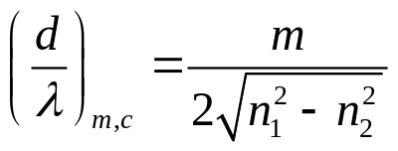
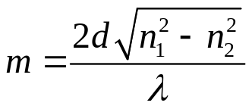
DIELECTRIC SLAB WAVEGUIDE
January 2010
  Higher order modes cannot propagate because the normalised thickness is not large enough
  cut-off occurs when the propagation angle for a given mode just equals the critical angle
  The condition at cut-off for the m^{th} TE mode is
  if (d/λ) is less than this value, the m^{th} mode will not propagate
  Highest order mode that can propagate has a value m:
© Alan P. Morrison

Slide 5
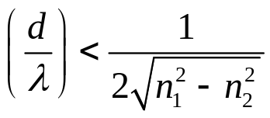
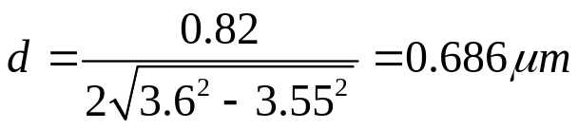
DIELECTRIC SLAB WAVEGUIDE
January 2010
    To minimise the number of modes, we can make (d/λ) small, or make n₂ close to n₁.
    If we wish to propagate only the TE₀ mode, then:
  Example: Compute largest thickness that will guarantee single-TE-mode operation at 0.82μm in the AlGaAs slab waveguide.
    Maximum thickness:
    note how thin the film must be, to be single mode.
© Alan P. Morrison

Slide 6
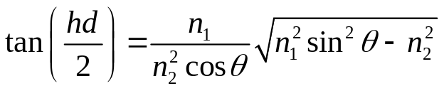
DIELECTRIC SLAB WAVEGUIDE
January 2010
    Multimode waveguide supports more than one propagating mode
    rays of higher order modes travel more steeply with respect to the waveguide axis than do rays of lower-order modes
TM mode chart:
    solution for even modes having this polarization is:
    for odd modes (hd/2) is replaced by (hd/2)-(π/2)
    this differs from the TE mode solution, but the difference is negligible when n₁ is close to n₂.
© Alan P. Morrison

Slide 7
DIELECTRIC SLAB WAVEGUIDE
January 2010
  For the AlGaAs example, n₁ is close to n₂ and hence the TM results are nearly identical to the TE case
  They have about the same effective index and propagation angle, but their electric field vectors point in orthogonal directions
  2 modes with same propagation factor are degenerate.
  No. of propagating TM modes = no. of propagating TE modes
  N.B. single mode operation not possible by just making film negligibly thin as both TE₀ and TM₀ may propagate
© Alan P. Morrison

Slide 8
DIELECTRIC SLAB WAVEGUIDE
January 2010
  Single mode obtained by polarising the incoming light into the desired mode (TE₀ or TM₀)
  Note that discontinuities or imperfections in the waveguide may depolarise the light and excite the unwanted mode
Mode pattern
  see diagram on next slide
  higher order modes attenuate more quickly than lower order modes
© Alan P. Morrison

Slide 9
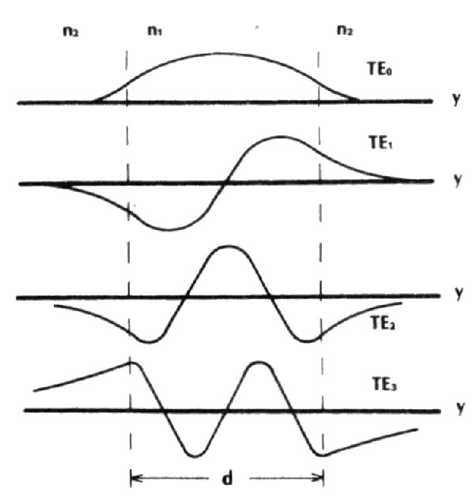
MODE PATTERN – SYMMETRIC WAVEGUIDE
January 2010
© Alan P. Morrison

Slide 10
DIELECTRIC SLAB WAVEGUIDE
January 2010
Modes in the asymmetric slab waveguide
  Consider waveguide with n₁=2.29, n₂=1.5, n₃=1.0
  represents a ZnS (for λ = 1.06μm) film on a glass substrate, upper film surface exposed to air
  critical angle for ZnS-air interface is 25.9º
  critical angle for ZnS-glass interface is 41º
  The ZnS film traps rays between 41º and 90º
  Rays between 25.9º and 41º are totally reflected at ZnS-air boundary, but not at ZnS-glass boundary, these leak into the substrate, causing high losses
© Alan P. Morrison

Slide 11
DIELECTRIC SLAB WAVEGUIDE
January 2010
Effective index for the asymmetric slab has range: n₂ <= n_{eff} <= n₁
mode chart developed as before, equations more complicated
Note cut-off of lowest order mode (TE₀) does not occur at zero thickness ( unlike symmetric case)
Here TE and TM modes are not degenerate - well separated
A true single mode waveguide exists if TM₀mode is cut-off, but not the TE₀ mode
© Alan P. Morrison

Slide 12
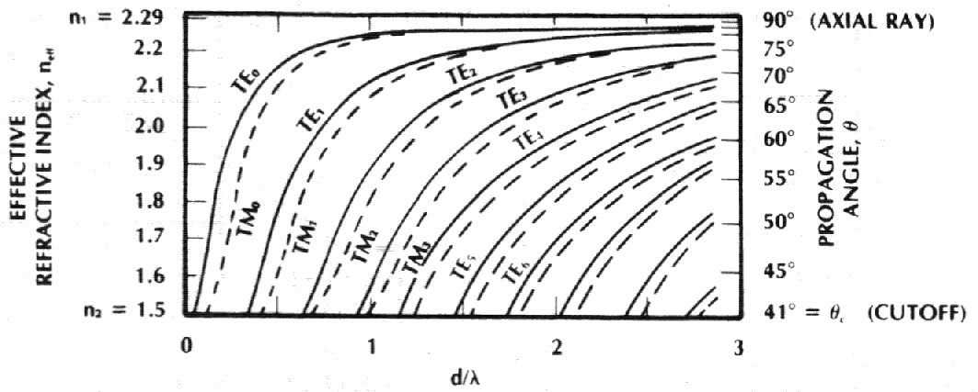
MODE-CHART FOR ASYMMETRIC WAVEGUIDE
January 2010
© Alan P. Morrison

Slide 13
DIELECTRIC SLAB WAVEGUIDE
January 2010
Mode patterns for asymmetric slab are similar to symmetric waveguide (evanescent decay quicker into lower n material)
mode indicator (m) is still the number of zero crossings
asymmetry causes the fields to have unequal amplitudes at the two boundaries and to decay at different rates in the upper and lower layers
see diagram on next slide for mode patterns
© Alan P. Morrison

Slide 14
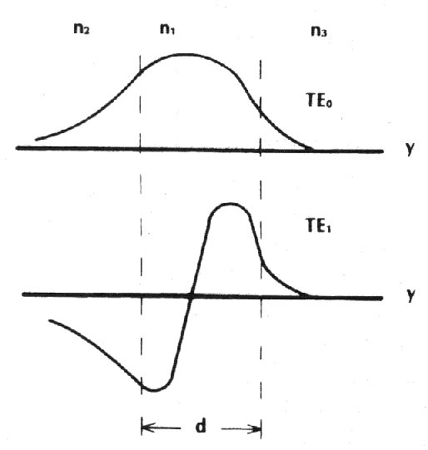
ASYMMETRIC WAVEGUIDE – MODE PATTERNS
January 2010
© Alan P. Morrison

Slide 15
COUPLING LIGHT INTO WAVEGUIDE
January 2010
Several techniques - edge, prism, grating coupling
Edge coupling most important for our application
    edge coupling / butt coupling appears simple and efficient
    Example: LD or LED coupling to film
    Problems: emitting area of source must be <= film cross section
    Difficult - single mode operation => film ~ 1μm
© Alan P. Morrison

Slide 16

COUPLING LIGHT INTO WAVEGUIDE
January 2010
Other problems: perfect mode coupling requires transverse radiation pattern of source to match that of mode patterns of allowed waveguide modes
To excite any particular mode, the plane wave incident on the slab must provide the desired internal angle θ.
Snell’s law can be used to show that this yields the numerical aperture of the waveguide
The maximum incident angle that will be coupled into the waveguide is called the acceptance angle
© Alan P. Morrison

Slide 17
COUPLING LIGHT INTO WAVEGUIDE
January 2010
Only light falling within the acceptance angle can be captured by the waveguide
Power will also be rejected from rays within the acceptance angle that do not produce rays in the film at one of the discrete allowed angles.
Numerical aperture is a useful measure of the angular light gathering ability of waveguides that are thick enough to support many modes
Numerical aperture is also useful for determining the range of emission angles from the waveguide
© Alan P. Morrison

Slide 18
COUPLING LIGHT INTO WAVEGUIDE
January 2010
Thin films (less modes) radiate light into a pattern corresponding to the discrete propagating modes - exact distribution of any one mode is determined by diffraction
Additional coupling loss comes from reflection at the air dielectric interface e.g. for an AlGaAs film (n=3.6) approx. 32% of the normal incident light is reflected.
Butt coupling has limitations, but useful for low-power simple designs
If source is larger than waveguide => use a lens to reduce the beam size.
© Alan P. Morrison

